Slide 1
INTRODUCTION TO TECHNICAL WRITING

Slide 2
GCR CODE: vdsmya5
Email: madiha.rehman@nu.edu.pk
Office location: EE Building, 2nd floor, Office 7.

Slide 3
Class Schedule
1 Hour theory class thrice a week.

Slide 4
Task 1
Write 50-75 words about your cell phone/ smart watch/ laptop etc

Slide 5
OUTLINE TILL MID-I
Orientation class
Technical Writing: Definitions, History, Purposes, Functions, Defining Characteristics
The Technical Style: Clarity, Precision, Objectivity, Simplicity, &Economy
The Technical Writing Process- Purpose analysis & Audience Analysis
Data Collection & Analysis- Primary & Sources, Qualitative & Quantitative Data
Constructing Effective Paragraphs for the technical prose
Writing Review Articles
How to write instructions in user guides
Activity: Making a User guide

Slide 6
Marks Distribution
Particular
1. Quiz 5%
2. Assignments 5 %
4. Class participation 3 %
5. Project & viva 7 %
6. Mid-Terms 15 %
7. Final Exam 50 %
Total 100

Slide 7
Week-1
Technical Writing:
Definitions,
History, Purposes
Functions
Defining Characteristics

Slide 8
Genres of Writing
Fiction | Non-Fiction
Drama, Poetry, Novel, Short story | Essays, Reports, Research Thesis, Research Papers, Memos, Articles, Editorials Review Letters

Slide 9
The Importance of Writing
• It helps you record history.
• It helps you transmit and preserve religious and cultural values, ideologies, and views.
• It helps you serve people by providing you a means via which we can share knowledge, experience, observation, insight, etc.
• It helps nations grow.
• It helps us guide, instruct, etc.
• It helps immortalize ideas, insights, etc.
• It helps preserve a particular language through codification.
• It is the most appropriate medium of communication in a great majority of cases.
• It makes things permanent and long lasting. Word of mouth is not considered reliable, but the written word carries immense power.

Slide 10
What is Technical Writing?
“It is a long-established and important professional activity that can be defined as a specialized field of communication whose purpose is to convey technical and scientific information and ideas accurately and efficiently.”

Slide 11
TW as a Profession
The United States Department of Labor, recognizes technical writer as a distinct job category, stating that technical writers produce Instruction manuals and other supporting documents to communicate complex and technical information more easily. They also develop, gather, and disseminate technical information among customers, designers and manufacturers.
The Society for Technical Communication, the largest professional organization dedicated to advance in the arts and sciences of technical communication, would call a technical writer a technical communicator. Besides, a technical writer can be called as a documentation specialist, information developer, to name just a few

Slide 12
The Importance of Technical Writing:
In most of the cases, these reports and documents are one’s only form of communication with clients, government agencies, managers, and professionals at other facilities and companies.
The recipient will usually use the report or document to perform a task, make a decision, solve a problem, or acquire information and knowledge.

Slide 13
Technical Specifications for Manufacturing Tennis Shoes
The D40 Slammer Tennis Shoe will be manufactured to the following specifications:
Sole: Neoprene rubber #345 white enameled paint 1.589" high Slammer waffle-textured©
Uppers: Blue canvas
Tongue: White canvas Oval Slammer© logo heat pressure sealed, centered .50" from all sides
Laces: 15" long ,100% cotton
Aglets: Clear poly acetate plastic #290 Weight: 1 lb. 6 oz.
Ode to a Shoe
My son’s tennis shoes rest temporarily in a heap against the kitchen door,
their laces soiled, their tongues hanging out like exhausted terriers.
The soles, worn down on the insides from sliding into second,
are green, the shades of summer.
Canvas exteriors, once pristine white, are the colors of the rainbow—
sun bleached, mud splattered, rained on, ketchup and mustard adorned,
each shoe shouting a child’s joyous exuberance: “I’m alive!”

Slide 14
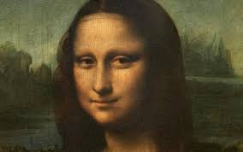

Slide 15
Let’s Compare!
The ever elusive smile, the misty atmosphere, the hazy landscape in the background and, most of all, the ambiguous, inscrutable expression on the face of the sitter entrap the imagination, leaving questions open and fancy disturbed.
Mona Lisa’s exceedingly serene, indifferent disposition further deepens the uncertainty and excites curiosity.
The identity of Leonardo da Vinci's model for his painting Mona Lisa
(Fig. 1) has plagued historians for over 500 years [1]. Early writings stated that mouth and eyes are not distinct [4].
The lower lids are almost horizontal and the absence of eyebrows is striking [7]. The hands appear boneless [6].
Finally, the dress is timeless and quite plain, with no accompanying emblems, jewelry, or accessories [7], unlike that one would have expected had a conventional model been used.

Slide 16
Technical Writing Examples
Instruction manuals
Procedure Guidelines
Reports
Specifications
Proposals
CV/Resumes
Business correspondence (letters and memos)
Research papers and articles
Other technical documents

Slide 17
Technical Communication
Technical/Professional
Business
Scientific
Subject/field specific experts produce it as it requires expertise (professional qualification/training) in the subject. E.g. progress report, manuals, procedures, planning document, bug report
It aims to run (administer and manage) the business. Resume, Cover letter, administrative communication.
It aims to report researches and discoveries to advance the field. E.g. Books, Journals, Magazine, conference, website or blog.

Slide 18
OK, now you know!
Which adjectives/nouns do you think can best describe technical
writing and technical writers?
Imaginative/objective/dreamy/sensational/precise/straightforward/subjective/
researcher/meticulous/creative/conformity/direct/experimental/innovative/exact/
vague/scrupulous/dramatic/sober/
emotional

Slide 19
Some more practice!
What genres of writing do you think the following documents belong to? Choose from the options below.
Essay/poetry/articles/press release/user manuals/novels/research papers/
brochures/news reports/pamphlets/
memos/drama/reviews/feasibility studies/
literature reviews/instructions

Slide 20
Common Purposes of Technical Writing
To inform
To instruct
To persuade

Slide 21
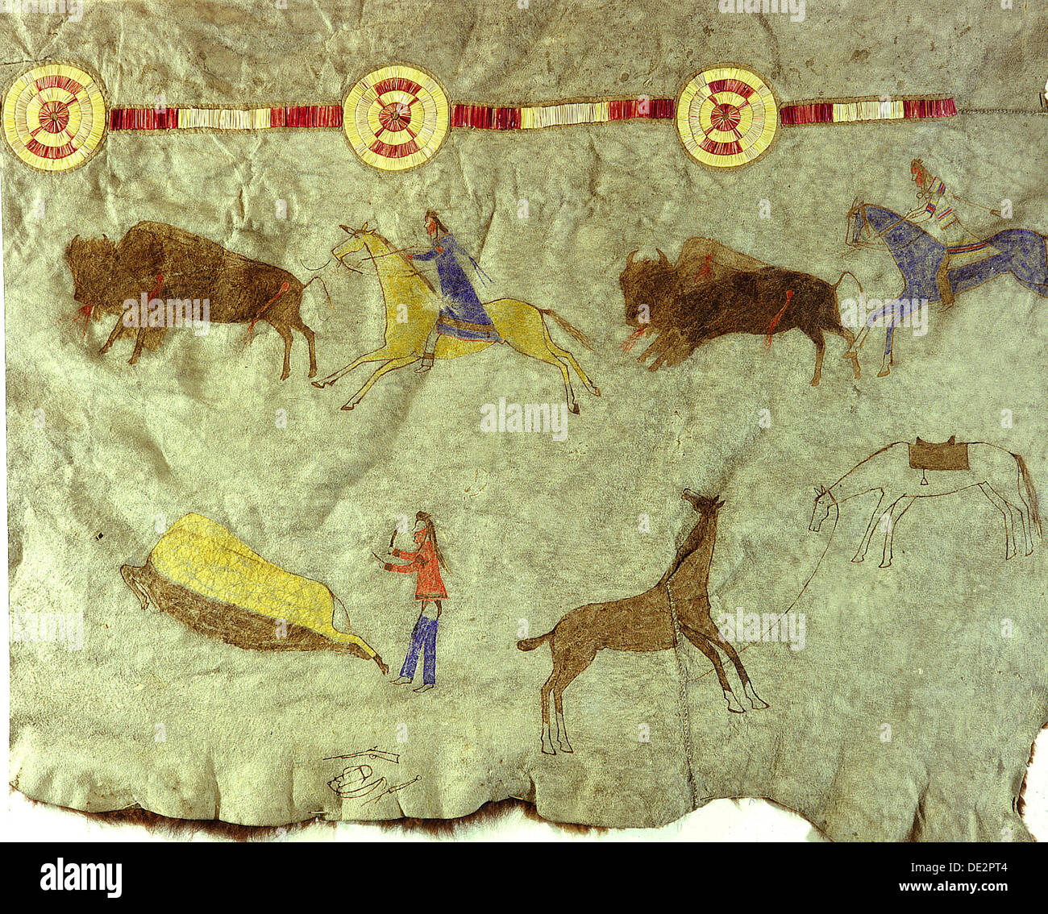
History of TW

Slide 22
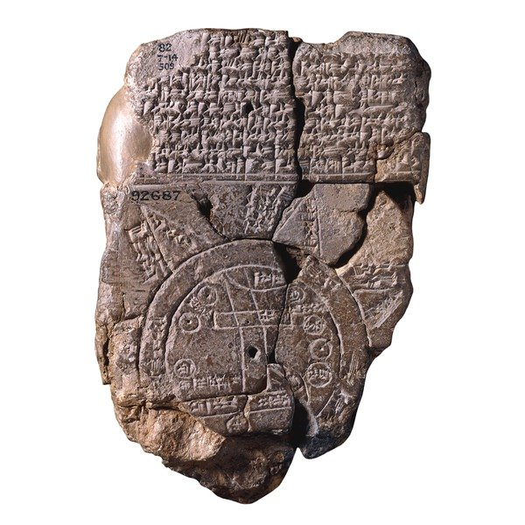

Slide 23
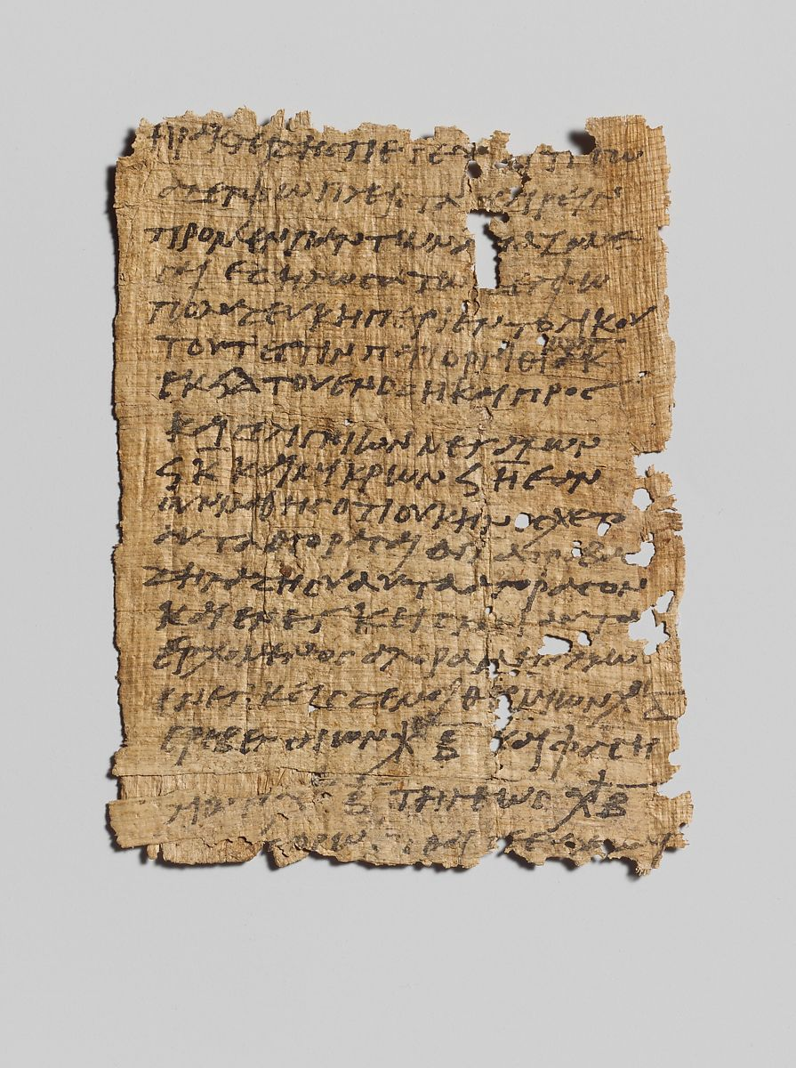

Slide 24
Some rules of thumb for TW
What makes a good writer?
Having something to say
Logical thinking
A few learnable rules of style
Read everything (decent and good quality material of course!)
Observe the writer and imitate (his writing talent!)
Superb research skills
Discuss your topic and content (with a trusted someone)
Revise, revise, revise
Edit

Slide 25
Skills Needed to be a Good Technical Writer
Subject Knowledge
Writing Skills
Research Skills
Knowledge of the conventions of Technical Communication

Slide 26
Handout Time
Do the following.
Read the handout. Study the definitions of TW, its
history, functions, purposes, and its importance for
Computer science students and write a short body
paragraph on your learning and understanding and
share it with the class.

Slide 27
Discuss
How exactly should one approach technical communication?
Talk about the right style, etiquette, and
strategies.

Slide 28
Complete the exercises given on page 11 to 16

